Slide 1

Spam Email Filter Machine Learning Model

Slide 2
Agenda
01
02
03
04
05
06
Business Problem
Exploratory Data Analysis
Predictive Modeling
Conclusions
Recommendation
Next Steps

Slide 3

Business Problem
01
Our telecommunications company wants to break into the email market and needs to implement an effective SPAM filter.
We are charged with:
Create a model that reliably detects SPAM in a way that will maximize customer satisfaction

Slide 4

Data Analysis
02
Actual emails in the form of individual HTML files were used in the analysis
Source: Index of /old/publiccorpus (apache.org)
5280 HTML files in total
Each email was previously labeled as HAM or SPAM and sorted into folders
Notes:
Mention got it from kaggle

Slide 5
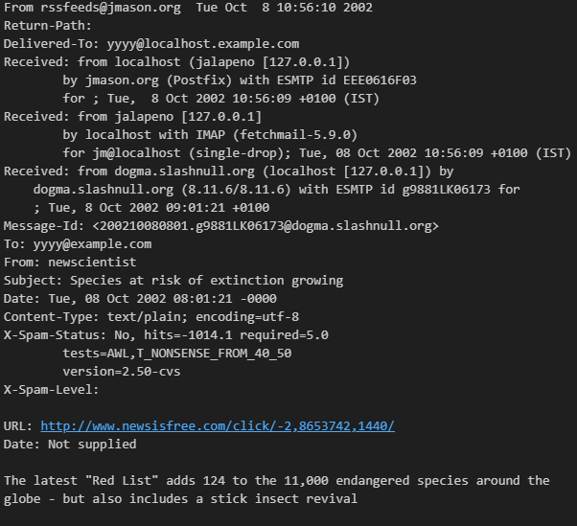
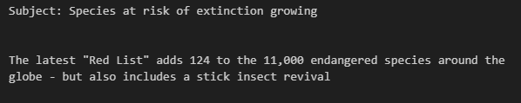
Email Importing and Preprocessing

Slide 6
Subject Line vs Email Body
Subject Line:
- We expect ‘dense’ information about the nature of the email
Email Body:
- More information about the nature of the email, more verbose
Modeling the Subject and Body separately…
Notes:
Class imbalance (give examples)

Slide 7
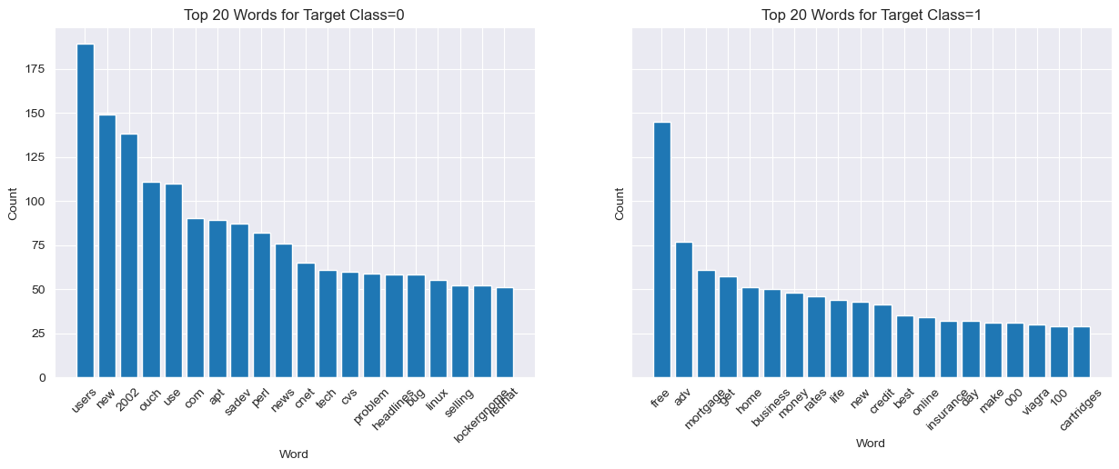
Subject Line Word Count by Target Class
Note: Models are built on company internal email data, will need to adjust models trained on anonymized customer emails data after deployment

Slide 8
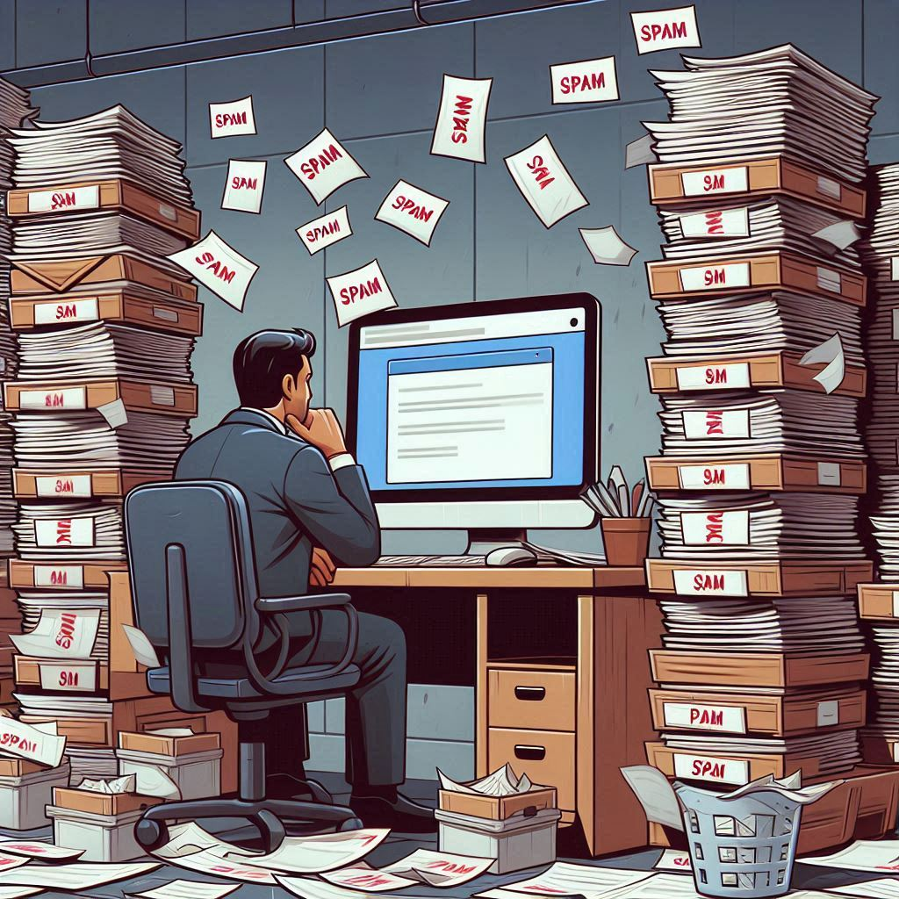
Predictive Modeling
03
BUSINESS REQUIREMENT: Less than 1% of customers HAM emails are allowed to go to the SPAM classification
Getting SPAM irritates our customers, but missing HAM because we classified it as SPAM will really anger them!
Optimizing models on Precision, then Accuracy
Notes:
Priority: Recall Score: How well we can detect if LATE, even if we might be wrong sometimes
Prioritizes customer retention by avoiding LATENESS
Secondary: Accuracy Score: How correctly we can detect if LATE or ON-TIME
Evaluates the overall correctness of the model
Avoid wasting resources on False Positives

Slide 9
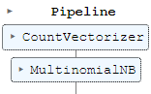
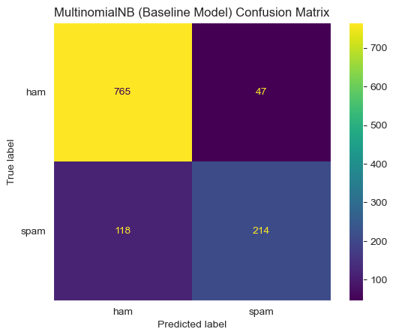
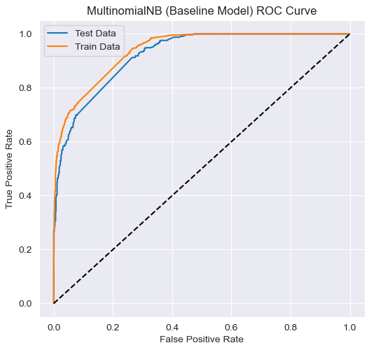
Subject Line Baseline Model

Slide 10
Subject Line Final Model

Slide 11
Email Body Baseline Model

Slide 12
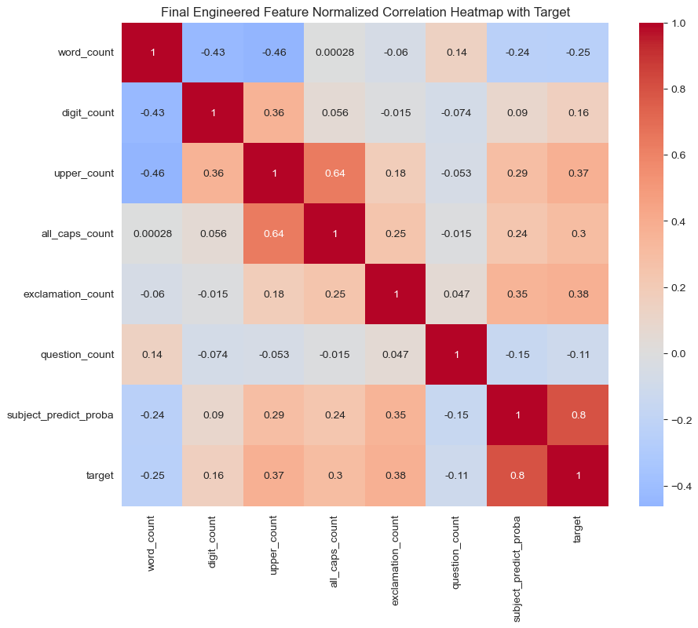
Email Body Feature Engineering
SUBJECT LINE PREDICTIONS

Slide 13
Email Body With Feature Engineering

Slide 14
Email Body – Best Naive Bayes Model

Slide 15
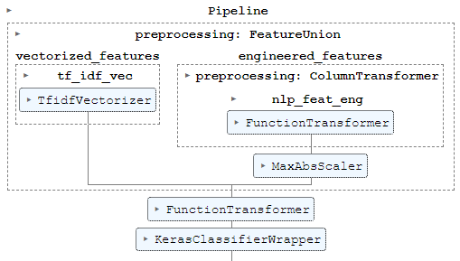
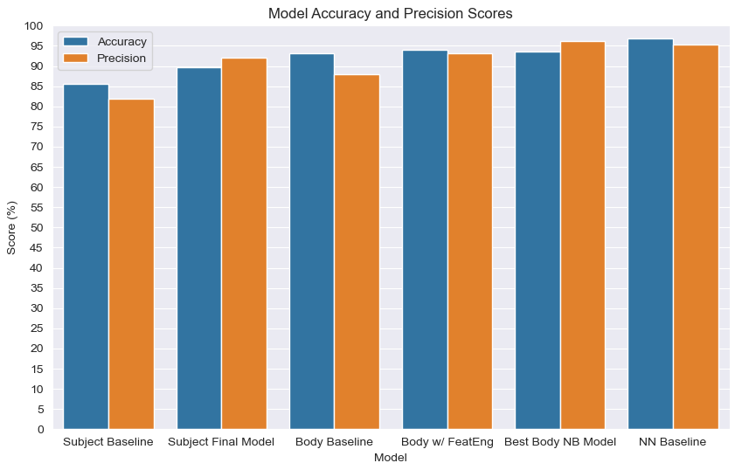
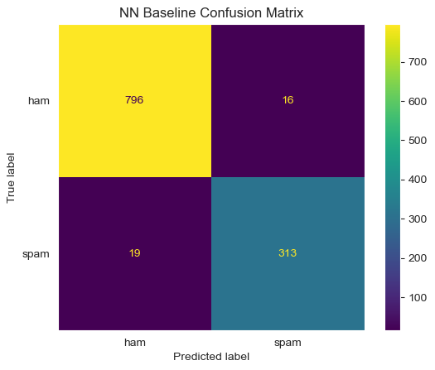
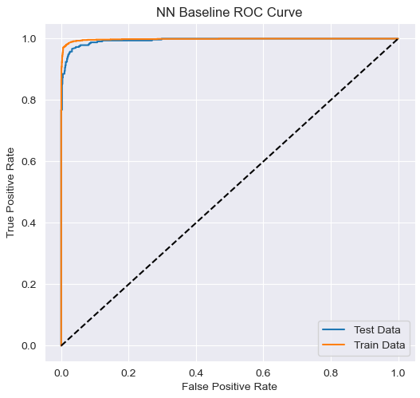
Email Body – Neural Network Baseline
One hidden layer

Slide 16
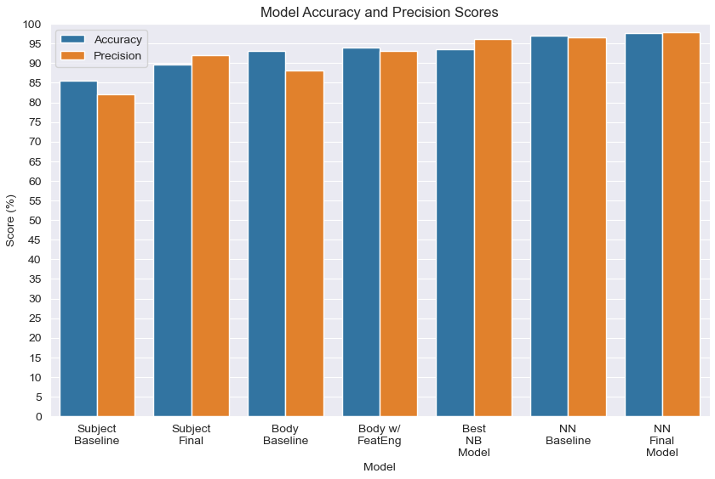
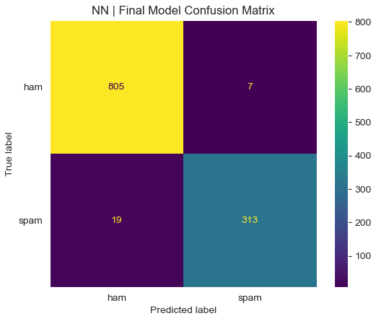
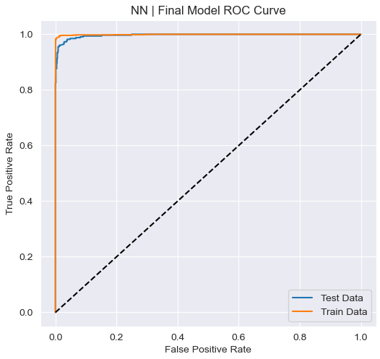
Email Body – Neural Network Final
5 hidden layers
2 dropout layers
Gridsearch using Hyperband()

Slide 17
Conclusion
04
Final Model Test Metrics:
Precision: 97.7%
Accuracy: 97.8%
Final Business Metrics:
False Pos Rate (HAM going to SPAM): 0.9%
False Neg Rate (SPAM going to HAM): 6%
Notes:
In conclusion, the Average Probability Classifier provides the best balance between recall and accuracy, ensuring that we minimize false negatives while maintaining a reasonable number of false positives.
We predict on-time or late correctly 63% of the time
We predict truly late shipments 85% of the time

Slide 18

Recommendation
05
Implement the best Neural Network model during initial Email service rollout
Continue to retrain and retune the models on new anonymized customer data
Investigate other potential model architectures (RandomForest, XGBoost)

Slide 19
Next Steps
06
Acquire larger data sets of up-to-date, real emails
Investigate SPAM detection models for calls and texts
Notes:
Recall getting 1
Decided to use roc_auc score and play with thresholds to decrease fn

Slide 20



Thanks!
Do you have any questions?
Dale DeFord
daledeford@gmail.com

